Slide 1
Chapter 03
Knowledge Management Models
Notes:
https://slideplayer.com/slide/8315484/

Slide 2
Objectives
Major Theoretical KM Models
Strategic Implications of KM Models
Practical Implications of KM Models

Slide 3
Introduction
In an economy where the only certainty is uncertainty, the one sure source of lasting competitive advantage is knowledge.
Data: A set of discrete, objective facts about events.
Information: A message, usually in the form of a document or an audible or visible communication .

Slide 4
Introduction
Knowledge: A fluid mix of framed experiences, values , contextual information , and expert insight that provides a framework for evaluating and incorporating new experiences and information. It originates and is applied in the minds of knower. In organizations, it often becomes embedded not only in documents or repositories but also in organizational routines, processes, practices , and norms.

Slide 5
Major Theoretical KM Models
The von Krogh and Roos Model of Organizational Epistemology
The Nonaka and Takeuchi knowledge spiral Model
The Choo sense-making KM Model
The Wiig Model for Building and using knowledge
The Boisot I-Space KM Model
Complex Adaptive System Models of KM

Slide 6
Major Theoretical KM Models
Critical characteristics:
  1. Represent a holistic approach to knowledge management
  2. Be reviewed, critiqued, and discussed extensively in the KM literature—by practitioners, academics, and/or researchers.
  3. Be implemented and field-tested with respect to reliability and validity.

Slide 7
Major Theoretical KM Models
The von Krogh and Roos Model of Organizational Epistemology
The Nonaka and Takeuchi knowledge spiral Model
The Choo sense-making KM Model
The Wiig Model for Building and Using Knowledge
The Boisot I-Space KM Model
Complex adaptive system models of KM

Slide 8
The von Krogh and Roos Model of Organizational Epistemology
The von Krogh and Roos KM model (1995) distinguishes between individual knowledge and social knowledge, and they take an epistemological approach to managing organizational knowledge: the organizational epistemology KM model.

Slide 9
The von Krogh and Roos Model of Organizational Epistemology
Whereas the definition of organization has been problematic and the term is often used interchangeably with information, a number of issues must be addressed:
  How and why individuals within an organization come to know.
  How and why organizations, as social entities, come to know.
  What counts for knowledge of the individual and the organization.
  What are the impediments in organizational KM.

Slide 10
The von Krogh and Roos Model of Organizational Epistemology
The cognitive perspective
  The cognitive perspective (e.g., Varela, 1992 ) proposes that a cognitive system, whether it is a human brain or a computer, creates representations (i.e., models) of reality and that learning occurs when these representations are manipulated.
  A cognitive organizational epistemology views organizational knowledge as a self- organizing system in which human s are transparent to the information from the outside.

Slide 11
The von Krogh and Roos Model of Organizational Epistemology
The connectionist approach
  The connectionist approach, on the other hand, is more holistic than reductionist, The brain is not assumed to sequentially process symbols but to perceive "wholeness," global properties, patterns, synergies, and gestalts.

Slide 12
The von Krogh and Roos Model of Organizational Epistemology
Von Krogh and Roos adopt the connectionist approach.
In their organizational epistemology KM model, knowledge resides both in the individuals of an organization and, at the social level, in the relations between the individuals.
Knowledge is characterized as embodied that is, “everything known is known by somebody”.
Unlike cognitivism, which views knowledge as an abstract entity, connectionism maintains that there can be no knowledge without a knower.

Slide 13
Major Theoretical KM Models
The von Krogh and Roos Model of Organizational Epistemology
The Nonaka and Takeuchi knowledge spiral Model
The Choo sense-making KM Model
The Wiig Model for Building and Using Knowledge
The Boisot I-Space KM Model
Complex adaptive system models of KM

Slide 14
The Nonaka and Takeuchi knowledge spiral Model
Nonaka and Takeuchi (1995) studied the success of Japanese companies in achieving creativity and innovation. They quickly found that it was far from a mechanistic processing of objective knowledge.
Instead, they discovered that organizational innovation often stemmed from highly subjective insights that can best be described in the form of metaphors, slogans, or symbols.
The Nonaka and Takeuchi model of KM has its roots in a holistic model of knowledge creation and the management of "serendipity”.

Slide 15
The Nonaka and Takeuchi knowledge spiral Model
  Nonaka and Takeuchi argue that a key factor behind the Japanese enterprises‘ successful track record in innovation stems from the more tacit-driven approach to knowledge management.
  They maintain that Western culture considers knower and known as separate entities
  In contrast, the Japanese, through the structural characteristics of their language and through influences such as Zen Buddhism, believe in the oneness of humanity and nature, body and mind, self and other
  In such a cultural environment, knowledge is principally "group knowledge," easily converted and mobilized

Slide 16
The Nonaka and Takeuchi knowledge spiral Model
  Nonaka and Takeuchi underline the necessity of integrating the two approaches from the cultural, epistemological, and organizational points of view, in order to acquire new cultural and operational tools for better knowledge-creating organizations.
  Their construct of the hypertext organization formalizes the need for integrating the traditionally opposed concepts of Western and Japanese schools of thought

Slide 17
The Nonaka and Takeuchi knowledge spiral Model
The knowledge creation process
  Knowledge creation always begins with the individual.
  Making personal knowledge available to others in the company is at the core of this KM model.
  Knowledge creation consists of a social process between individuals in which knowledge transformation is not simply a unidirectional process but it is interactive and spiral.

Slide 18
The Nonaka and Takeuchi knowledge spiral Model
Knowledge conversion: There are four modes of knowledge conversion:
1. From tacit knowledge to tacit knowledge: the process of socialization.
2. From tacit knowledge to explicit knowledge: the process of externalization.
3. From explicit knowledge to explicit knowledge: the process of combination.
4. From explicit knowledge to tacit knowledge: the process of internalization.

Slide 19
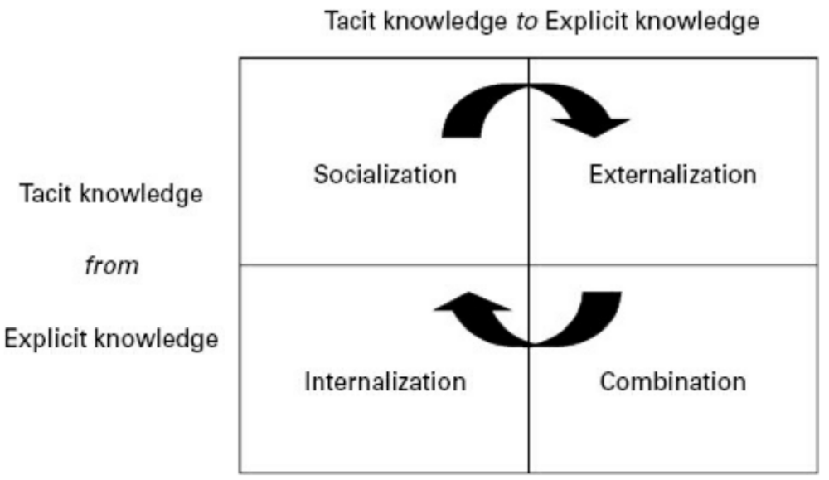
The Nonaka and Takeuchi knowledge spiral Model

Slide 20
The Nonaka and Takeuchi knowledge spiral Model
Knowledge Spiral
  Knowledge creation is not a sequential process
  Knowledge creation is not a sequential process. Rather, it depends on a continuous and dynamic interaction between tacit and explicit knowledge throughout the four quadrants.
  The knowledge spiral shows how organizations articulate, organize and systematize individual tacit knowledge.
  Organizations produce and develop tools, structures, and models to accumulate and share knowledge.

Slide 21
The Nonaka and Takeuchi knowledge spiral Model
Knowledge Spiral (con’t)
  The knowledge spiral is a continuous activity of knowledge flow, sharing, and conversion by individuals, communities, and the organization itself.
  The two steps in the knowledge spiral :
    externalization, which converts tacit into explicit know ledge
    internalization, which converts explicit into tacit knowledge.

Slide 22
The Nonaka and Takeuchi knowledge spiral Model
  They describe the following "Enabling Conditions for Organizational Knowledge Creation :
  1. Intention: an organization's aspiration to its goals (strategy formulation in a business setting).
  2. Autonomy: condition whereby individuals act autonomously, according to the "minimum critical specification" principle, and are involved in cross-functional self-organized teams.

Slide 23
The Nonaka and Takeuchi knowledge spiral Model
  3. Fluctuation and Creative Chaos: condition that stimulates the interaction between the organization and the external environment and/or creates fluctuations and breakdowns by means of creative chaos or strategic equivocality.
  4. Redundancy: existence of information that goes beyond the immediate operational requirements of organizational members; competing multiple teams on the same issue; and strategic rotation of personnel.
  5. Requisite Variety: internal diversity to match the variety and complexity of the environment, and to provide everyone in the organization with the fastest access to the broadest variety of necessary information; flat and flexible organizational structure interlinked with effective information networks.

Slide 24
The Nonaka and Takeuchi knowledge spiral Model
  The Nonaka and Takeuchi model has proven to be one of the more robust ones in the field of KM, and it continues to be applied in a variety of settings.
  Strengths:
    One of its greatest strengths is its simplicity-both in terms of understanding the basic tenets of the model and in terms of being able to quickly internalize and apply the KM model.

Slide 25
The Nonaka and Takeuchi knowledge spiral Model
Weakness:
  One of its major shortcomings is that, through valid, it does not appear to be sufficient to explain all of the stages involved in managing knowledge.
  The Nonaka and Takeuchi model focuses on the knowledge transformations between tacit and explicit knowledge, but the model does not address larger issues of how decision making takes place by leveraging both forms of knowledge.

Slide 26
Major Theoretical KM Models
The von Krogh and Roos Model of Organizational Epistemology
The Nonaka and Takeuchi knowledge spiral Model
The Choo sense-making KM Model
The Wiig Model for Building and Using Knowledge
The Boisot I-Space KM Model
Complex adaptive system models of KM

Slide 27
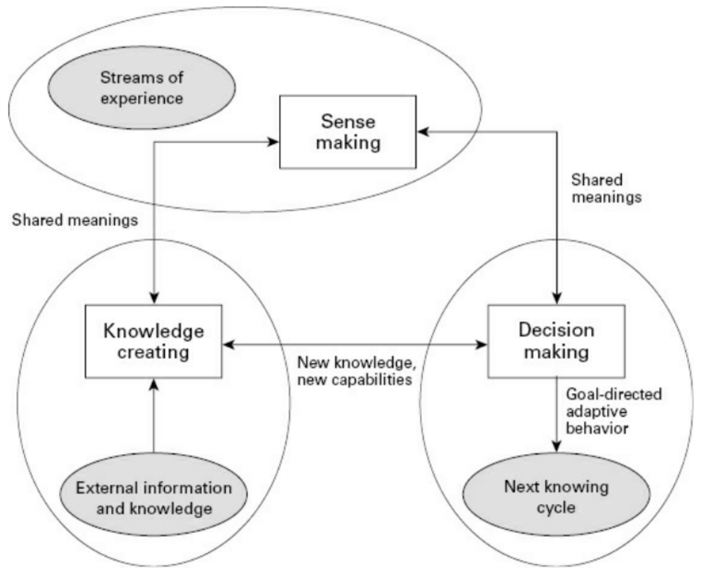
The Choo sense-making KM Model
Choo (1998) has described a model of knowledge management that stresses sense making, knowledge creation and decision making concepts, bounded rationality.
The Choo KM model focuses on how information element s are selected and subsequently fed into organizational actions.

Slide 28
The Choo sense-making KM Model
Sense-making:
  In the sense-making stage; one attempts to make sense of the information streaming in from the external environment .
  Weick (2001) proposes that sense making in organizations consists of four integrated processes: ecological change, enactment, selection, and retention.

Slide 29
The Choo sense-making KM Model
Sense-making (con’t):
  ecological change: is a change in the environment that is external to the organization- one that disturbs the flow of Information to participants and triggers an ecological change in the organization.
  enactment: people try to construct, rearrange, single out, or demolish specific elements of content.
  Selection & Retention: are the phases in which individuals attempt to interpret the rationale for the observed and enacted changes by making selections. The retention process in turn furnishes the organization with an organizational memory of successful sense-making experiences.

Slide 30
The Choo sense-making KM Model
Knowledge creation:
  Knowledge creating may be viewed as the transformation of personal knowledge between individuals through dialogue, discourse, sharing, and storytelling.
  This phase is directed by a knowledge vision of "as is" (cur rent situation) and " to be" (future, desired state). Knowledge creation widens the spectrum of potential choices in decision making by providing new knowledge and new competencies.

Slide 31
The Choo sense-making KM Model
Decision making
  Decision making models that are used to identify and Decision making is situated in rational decision- making models that are used to identify and evaluate alternatives by processing the information and knowledge collected to date.
  There are a wide range of decision-making theories such as the theory of games and economic behavior
  The Garbage Can model (GCM) of organizational decision making was developed in reference to "ambiguous behaviors," that is, explanations or interpretations of behaviors that at least appear to contradict classical theory.

Slide 32
Major Theoretical KM Models
The von Krogh and Roos Model of Organizational Epistemology
The Nonaka and Takeuchi knowledge spiral Model
The Choo sense-making KM Model
The Wiig Model for Building and Using Knowledge
The Boisot I-Space KM Model
Complex adaptive system models of KM

Slide 33
The Wiig Model for Building and Using Knowledge
Wiig (1993) approached his KM model with the following principle:
  In order for knowledge to be useful and valuable, it must be organized. Knowledge should be organized differently depending on what use will be made of the knowledge.
  Some useful dimensions to consider in Wiig's KM model include:
        1. Completeness
        2. Connectedness
        3. congruency
        4. perspective and purpose

Slide 34
The Wiig Model for Building and Using Knowledge
Some useful dimensions to consider in Wiig's KM model include:
      1. Completeness
      2. Connectedness
      3. Congruency
      4. Perspective and purpose

Slide 35
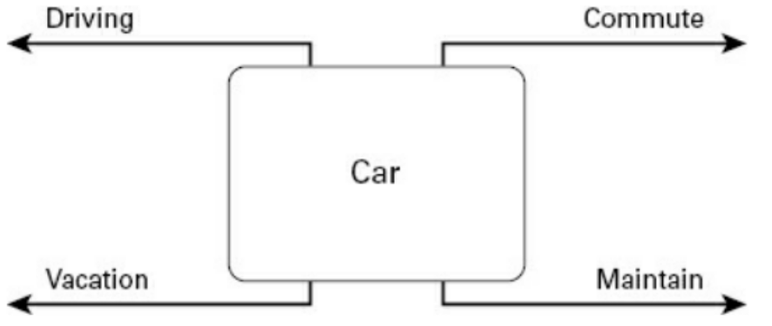

The Wiig Model for Building and Using Knowledge

Slide 36
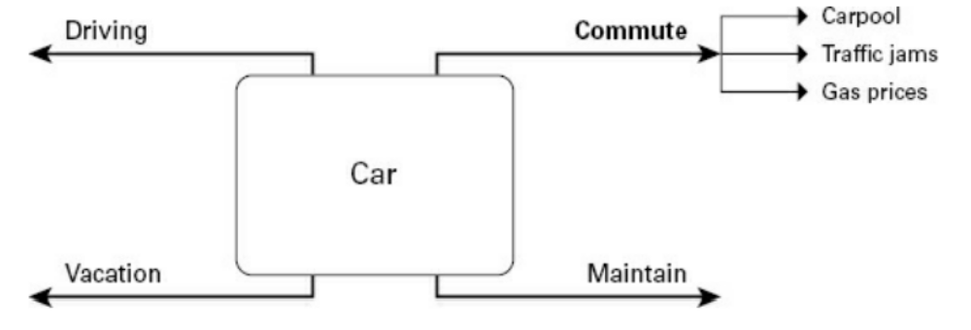
The Wiig Model for Building and Using Knowledge

Slide 37
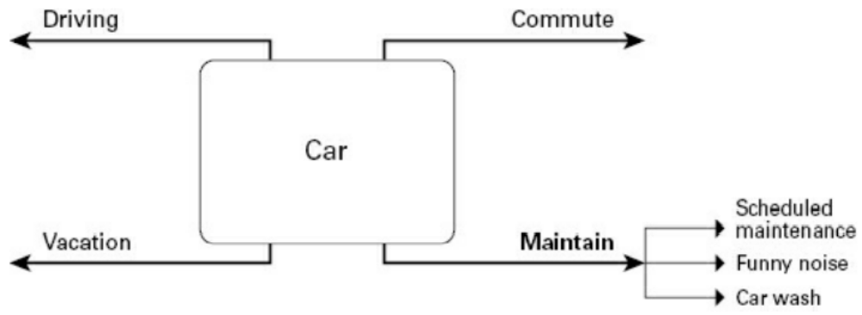
The Wiig Model for Building and Using Knowledge

Slide 38
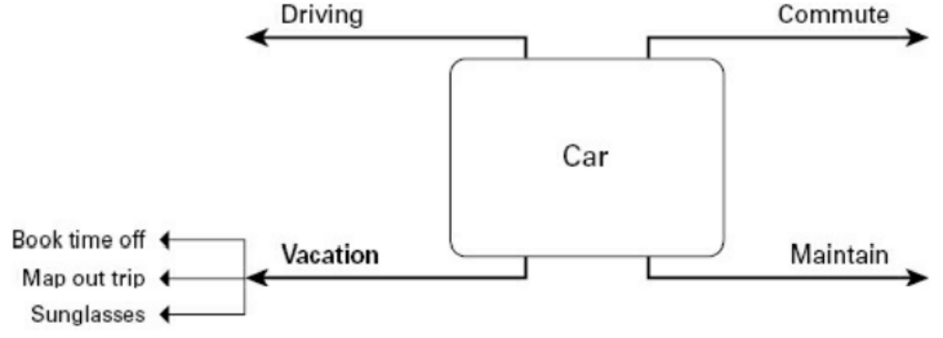
The Wiig Model for Building and Using Knowledge

Slide 39
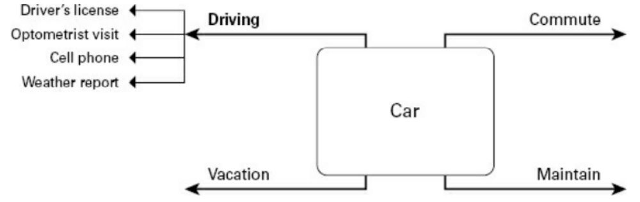
The Wiig Model for Building and Using Knowledge

Slide 40
The Wiig Model for Building and Using Knowledge
Level | Type | Description
1 | Novice | Barely aware or not aware of the knowledge and how it can be used
2 | Beginner | Knows that the knowledge exists and where to get it but cannot reason with it
3 | Competent | Knows about the knowledge, can use and reason with the knowledge given external knowledge bases such as documents and people to help
4 | Expert | Knows the knowledge, holds the knowledge in memory, understands where it applies, reasons with it without any outside help
5 | Master | Internalizes the knowledge fully, has a deep understanding with full integration into values, judgments, and consequences of using that knowledge

Slide 41

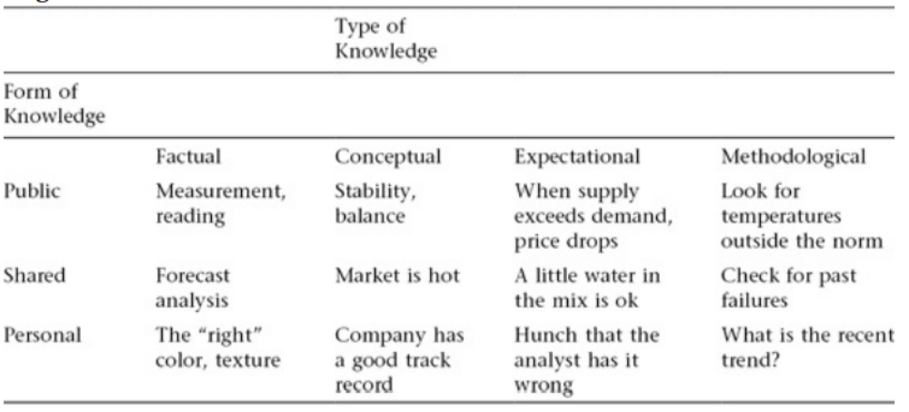
The Wiig Model for Building and Using Knowledge

Slide 42
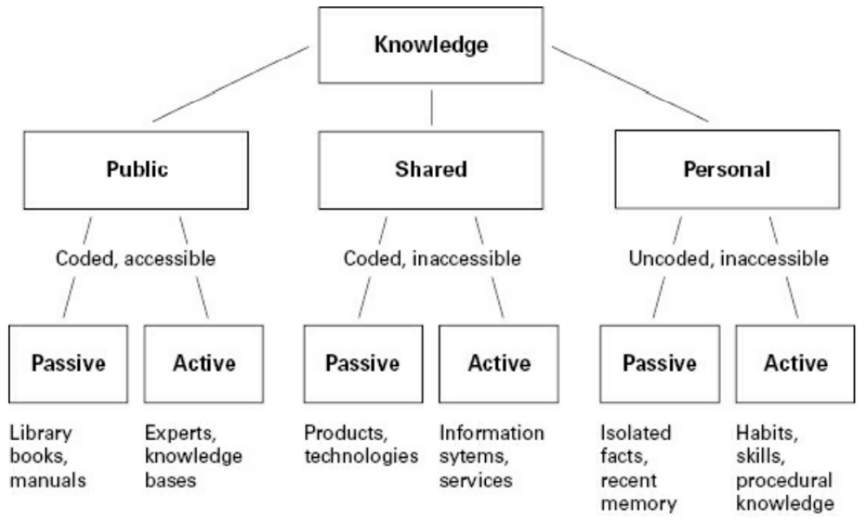
The Wiig Model for Building and Using Knowledge

Slide 43
Major Theoretical KM Models
The von Krogh and Roos Model of Organizational Epistemology
The Nonaka and Takeuchi knowledge spiral Model
The Choo sense-making KM Model
The Wiig Model for Building and Using Knowledge
The Boisot I-Space KM Model
Complex adaptive system models of KM

Slide 44
The Boisot I-Space KM Model
The Boisot KM model is based on the key concept of an "information good“ that differs from a physical asset.
Boisot distinguishes information from data by emphasizing that information is what an observer will extract from data as a function of his or her expectations or prior knowledge.

Slide 45
The Boisot I-Space KM Model
Boisot (1998) proposes the following two key points:
  1. The more easily data can be structured and converted into information, the more diffusible it becomes.
  2. The less data that has been so structured requites a shared context for its diffusion, the more diffusible it becomes.

Slide 46
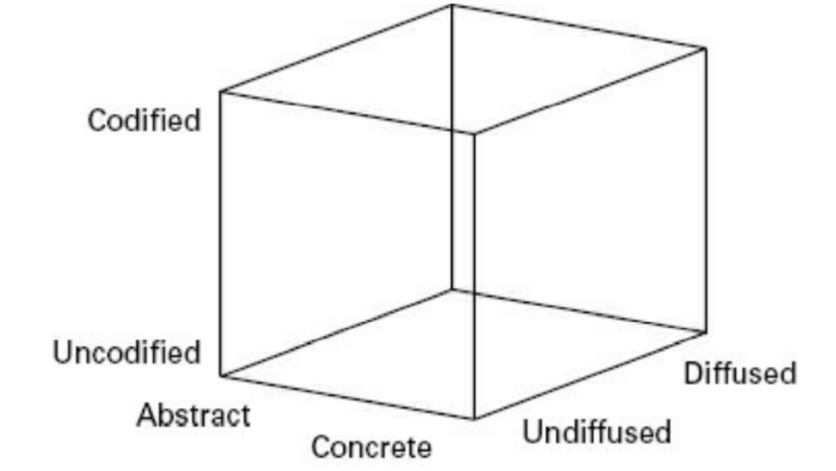
The Boisot I-Space KM Model

Slide 47
The Boisot I-Space KM Model
Phase 1: Scanning
  Identifying threats and opportunities in generally available but often fuzzy content
  Scanning patterns such as unique or idiosyncratic insights that then become the possession of individuals or small groups
  Scanning may be very rapid when the data is well codified and abstract and very slow and random when the data is uncodified and context-specific

Slide 48
The Boisot I-Space KM Model
Phase 2: Problem solving
  The process of giving structure and coherence to such insights—that is, codifying them;
  In this phase they are given a definite shape and much of the uncertainty initially associated with them is eliminated
  Problem solving initiated in the uncodified region of the I-Space is often both risky and conflict-laden

Slide 49
The Boisot I-Space KM Model
Phase 3: Abstracting
  Generalizing the application of newly codified insights to a wider range of situations
  Involves reducing them to their most essential features—that is, conceptualizing them
  Problem solving and abstraction often work in tandem

Slide 50
The Boisot I-Space KM Model
Phase 4: Diffusing
  Sharing the newly created insights with a target population
  The diffusion of well-codified and abstract content to a large population will be technically less problematic than that of content which is uncodified and context-specific
  Only a sharing of context by sender and receiver can speed up the diffusion of uncodified data
  The probability of a shared context is inversely achieving proportional to population size

Slide 51
The Boisot I-Space KM Model
Phase 5: Absorption
  Applying the new codified insights to different situations in a “learning by doing” or a “learning by using” fashion.
  Over time, such codified insights come to acquire a penumbra of uncodified knowledge which helps to guide their application in particular circumstances.

Slide 52
The Boisot I-Space KM Model
Phase 6: Impacting
  The embedding of abstract knowledge in concrete practices
  The embedding can take place in artifacts, technical or organizational rules, or in behavioral practices
  Absorption and impact often work in tandem

Slide 53
Major Theoretical KM Models
The von Krogh and Roos Model of Organizational Epistemology
The Nonaka and Takeuchi knowledge spiral Model
The Choo sense-making KM Model
The Wiig Model for Building and Using Knowledge
The Boisot I-Space KM Model
Complex adaptive system models of KM

Slide 54
Complex adaptive system models of KM
The ICAS is a conceptual model developed to bring out the most important capabilities necessary to live and contribute in an unpredictable, dynamic, and complex society.
The variation in human experience and behavior, together with the practical demands of the workforce and natural difficulties in communication create a reality that is often far from ideal.
Nevertheless, new concepts, perceptions, relationships, and communications are essential if our organizations are to keep up with the pace, direction, and demands of society in the age of complexity.

Slide 55
Complex adaptive system models of KM
The key processes in the ICAS KM model can be summarized as:
  1. Understanding.
  2. Creating new ideas.
  3. Solving problems.
  4. Making decisions.
  5. Taking actions to achieve desired results.

Slide 56
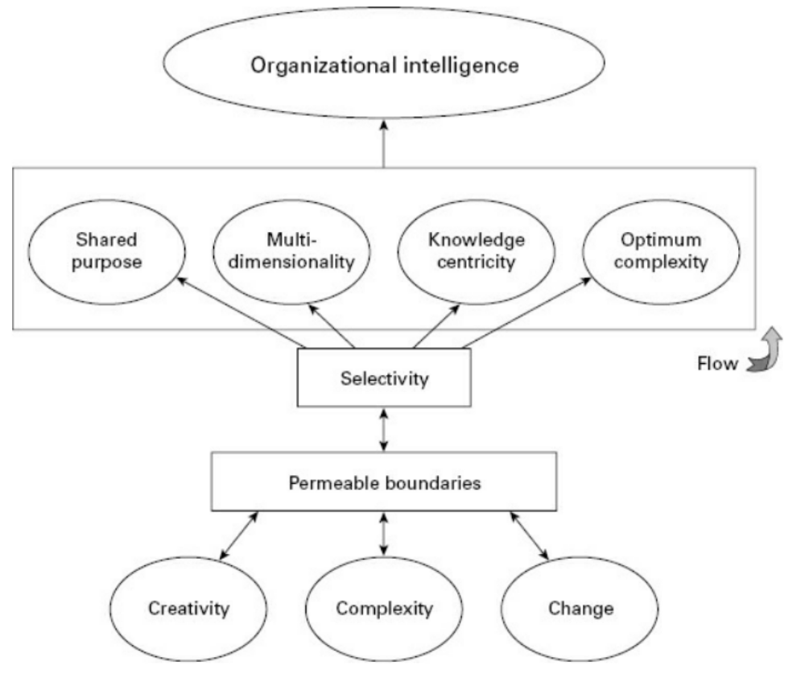
Complex adaptive system models of KM

Slide 57
Complex adaptive system models of KM
Complex adaptive system models of KM
  Organizational Intelligence
  Unity and Shared Purpose
  Optimum Complexity
  Multidimensionality
  Knowledge Centricity
  Selectivity
  Flow
  Permeable Boundaries

Slide 58
Complex adaptive system models of KM
Organizational intelligence
  Intelligence, according to Webster’s Dictionary (1996), is the capacity for reasoning and understanding or an aptitude for grasping truths.

Slide 59
Complex adaptive system models of KM
Organizational intelligence (con’t)
  When applied to organizations, Wiig (1993) broadens this view of intelligence and considers it the ability of a person to think, reason, understand, and act. He further considers intelligence as applying to organizations and includes the capabilities to innovate, acquire knowledge, and apply that knowledge to relevant situations. (From an organizational viewpoint, both employees and their organization can exhibit intelligent behavior.)

Slide 60
Complex adaptive system models of KM
Organizational intelligence (con’t)
  Organizational intelligence to be the ability of an organization to perceive, interpret, and respond to its environment in a manner that simultaneously meets its organizational goals while satisfying its stakeholders, that is, its employees, customers, investors, community, and environment. Although data and information are necessary for acting intelligently, it is the knowledge that is created and acted upon that is the critical factor for the ICAS.

Slide 61
Complex adaptive system models of KM
Unity and a shared purpose:
  Unity and shared purpose represents the ability of an organization Unity and shared purpose represents the ability of an organization to integrate and mobilize resources to:
    (1) provide a continuous line of focus and attention and
    (2) pull together the relevant parts of the organization when and where they are needed.

Slide 62
Complex adaptive system models of KM
Unity and a shared purpose:
  Senge (1990) addresses a partial solution to this problem in his management book, The Fifth Discipline. He emphasizes the importance of a shared vision where employees participate in the development of a corporate vision, and can then make decisions and take actions consistent with the direction set by senior leadership.

Slide 63
Major Theoretical KM Models
At any given moment, every individual and every organization has a huge number of signals impinging on its boundaries: data, information, sounds, images, ideas, etc. How the organization avoids becoming overwhelmed with these signals and is able to select, receive, process, and maintain a balance of unity, variety, and flexibility is an amazing feat.

Slide 64
Strategic Implications of KM Models
The require of a solid foundation of understanding what KM is, what the key KM cycle processes are, and how these fit in to a model that enables us to interpret, to establish cause and effect, and to successfully implement knowledge management solutions.

Slide 65
Practical Implications of KM Models
Measurement was the most influential component. The next in terms of level of influence were culture (including reward and motivation components) followed by technology as a strong enabler of KM.

Slide 66
Summary
Knowledge management encompasses data, information, and knowledge and it addresses both tacit and explicit forms of knowledge.
There are many KM models but they have common critical characteristics such as present, be reviewed and be implemented
The KM strategy models emphasize the importance of matching your KM model to the organizational business goals.
The collaboration models emphasize the critical success factors that must be in place if effective knowledge sharing is to occur, especially tacit knowledge sharing.

Slide 67

Discussion / Homework / Team Activities
Compare and contrast the cognitive and connectionist/constructivist approaches to knowledge management.
Describe how the major types of knowledge
Compare the Choo model similar to the Nonaka and Takeuchi KM model, the Wiig KM model related to the Nonaka and Takeuchi model?
Outline the general strategy you would use in order to implement the Boisot I-Space KM model
What is the major advantage of a complex adaptive system approach to a KM model? What are some of the drawbacks?
What additional factors do the EFQM and Inukshuk KM models introduce?
How would you go about identifying whether your company has a personalization KM strategy or codification KM strategy model?
What are some of the advantages of the knowledge jam over informal brainstorming?
What are some potential obstacles identified in the collaboration models?

